Slide 1

DQ Framework – UI Integrated

Slide 2
Key Points
The UI Integration is done through SP (Service principle)
We are using SQL warehouse for the APP
Whenever we need to manage rules from UI just start the app
A person has to be in Approvers list to approved a requested rule
A person must be part of group to access the tables

Slide 3
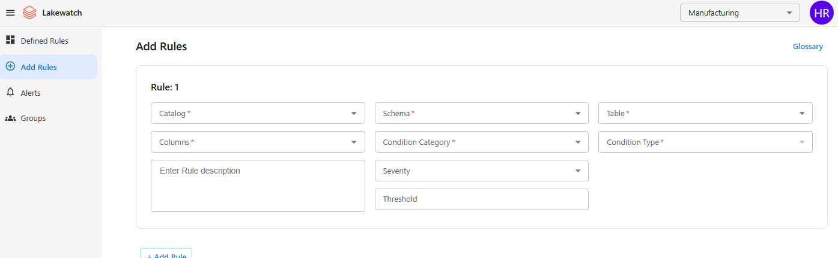
UI – when you are not part of Approvers list

Slide 4
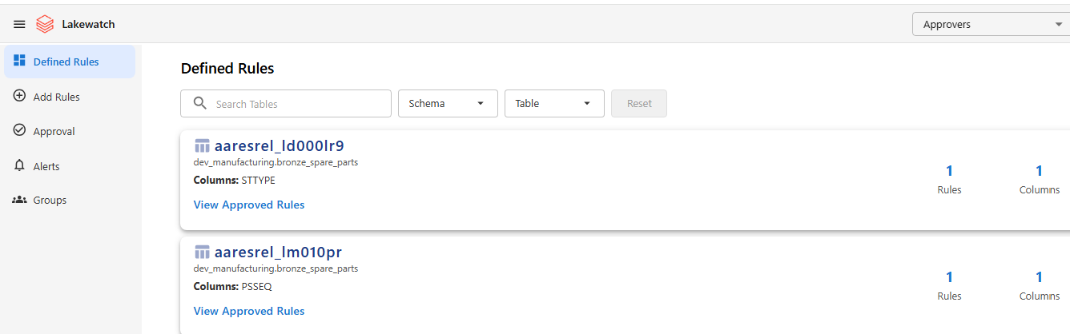
UI – For Approvers

Slide 5

Working Session

